Slide 1

ONLINE BANKING
RLL GROUP-3

Slide 2

Team leader : NAMRATA KUDACHI
TEAM MEMBERS : NAMRATA KUDACHI
RAHUL CHANDRA MANDAL
HARSHAVARDHAN K
KANNA KAVERI
N P SRISAKTHIKUMAR
NALAM ANANTHA LAKSHMI
SELVATHARANI A
SOMPALLI BHAVYA

Slide 3

CONTENTS
Problem Statement
Objective
Technologies Used
The Proposed System
Modules
System Architecture
Database
Flowchart
Output
Testing
Conclusion & Goals

Slide 4
PROBLEM STATEMENT
Online Bank Management System is a very simple and entry level project developed in java using spring boot and angular.
Here, A Database is used to store all the details of customer account in a table.
Users can login, do withdrawal, Request a Deposit amount, Transfer amount from one account to another account, check his/her current balance, and view reports of all the transactions.

Slide 5

OBJECTIVES
The Main Objective of Online Banking by commercial enterprise has been in existence much greater in number due to lower operating costs is associated .
Online Banking has been in the form of automatic teller machines and telephone transactions.
It has been transformed by the Internet, a new delivery channel for banking services that benefits both customers and banks.
Unlike your corner bank, online banking sites never close, they are available for 24/7.

Slide 6




TECHNOLOGIES USED
Front-end :Angular
Back-end: SpringBoot, Hibernate, JPA
Testing: TestNg, Selenium, Postman
Database : MySQL
Server Deployment :Tomcat

Slide 7
IMPLEMENTATION:
ANGULAR IMPLEMENTATION: Angular is used to develop the frontend application. As a framework, Angular has clear advantages while also providing a standard structure for developers to work with. Angular is a frontend framework that allows developers to write once and deploy to multiple platforms. SPRINGBOOT IMPLEMENTATION: SpringBoot is used perform the backend application. It is used to develop the API and operations like add, update, delete and view and connecting to MYSQL database.

Slide 8
THE PROPOSED SYSTEM
The development of this new system contains the following activities,
Customer must have a User- Id and password to login to the system.
The System provides the all bank operations like deposit, withdraw, and funds transfer between the two accounts.
The System providing the fully secured login features.

Slide 9
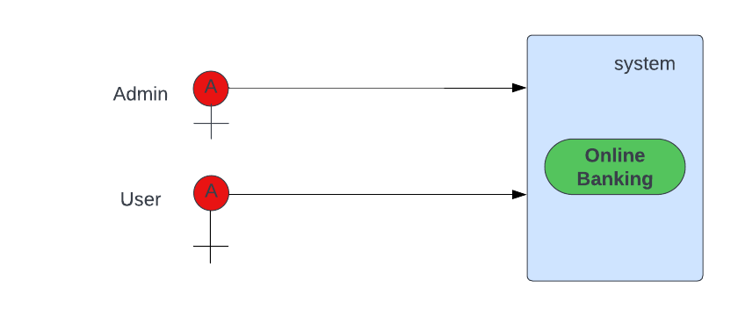
Use Case Diagram

Slide 10
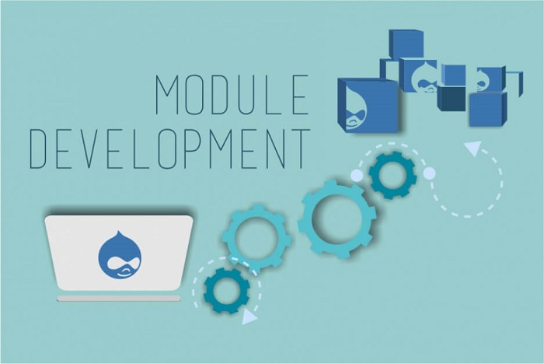
MODULES
The Modules involved are
Admin
Users

Slide 11
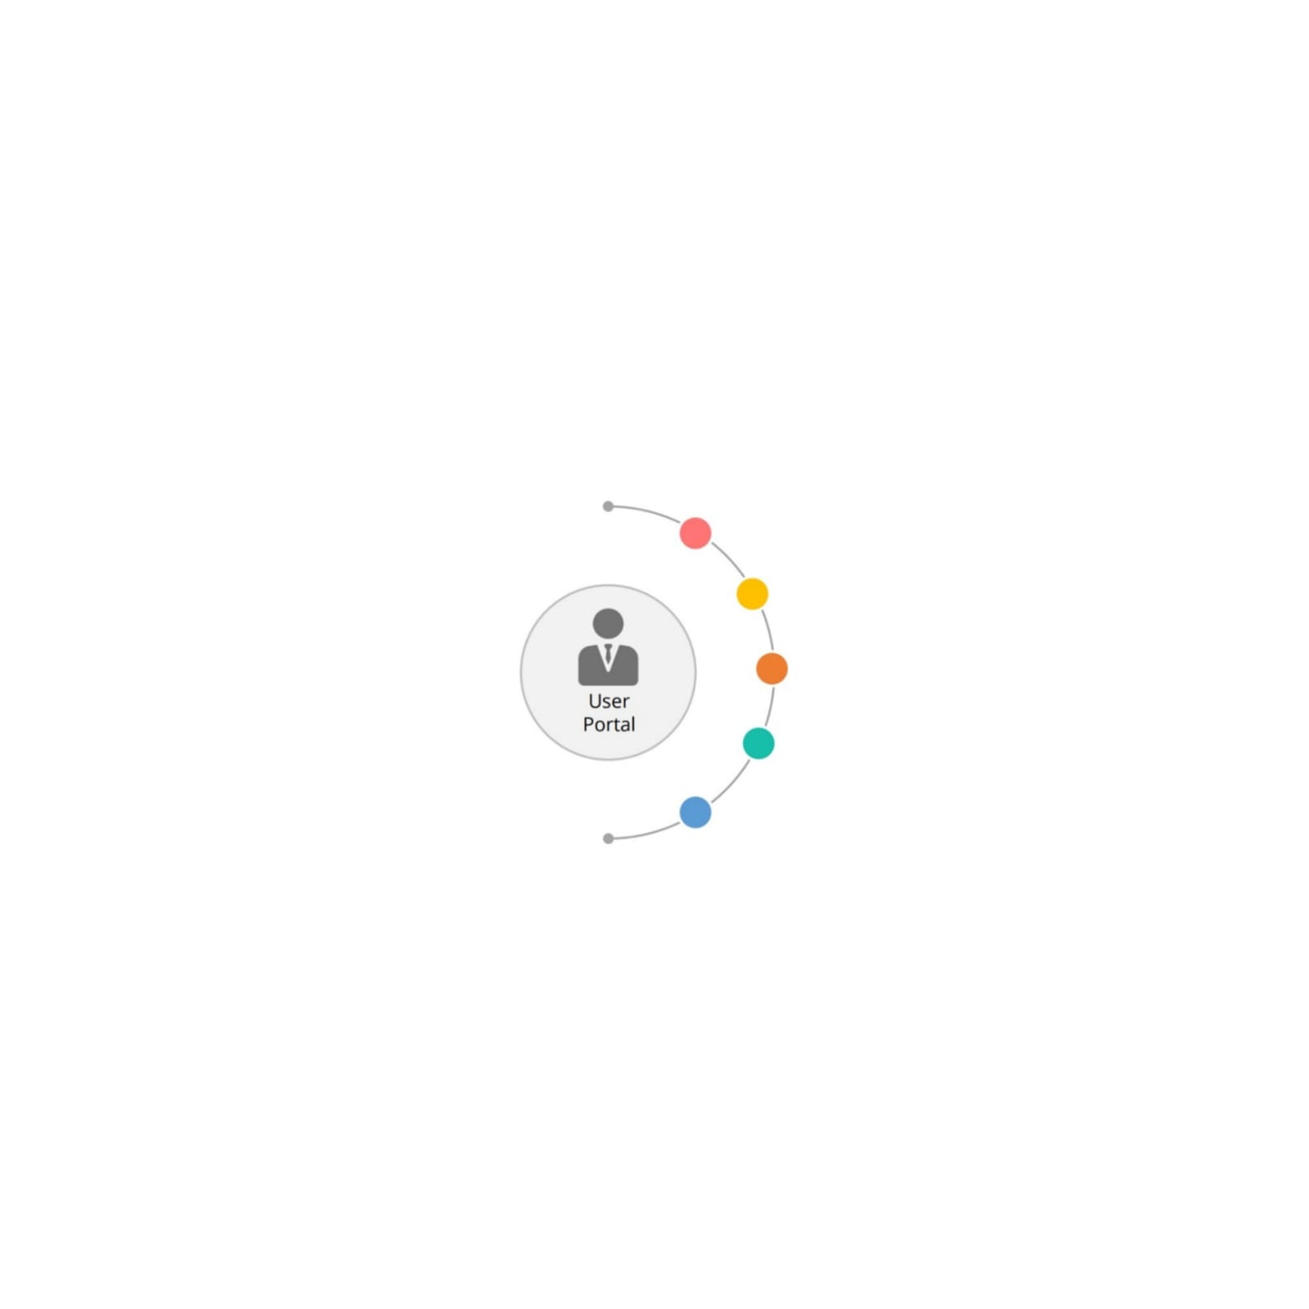

Module CONTD…
ADMIN MODULE:
The Admin Can View the Users
The Admin Approve the Cheque Book Requests and Loan requests
The administrator can also lock the user accounts

Slide 12
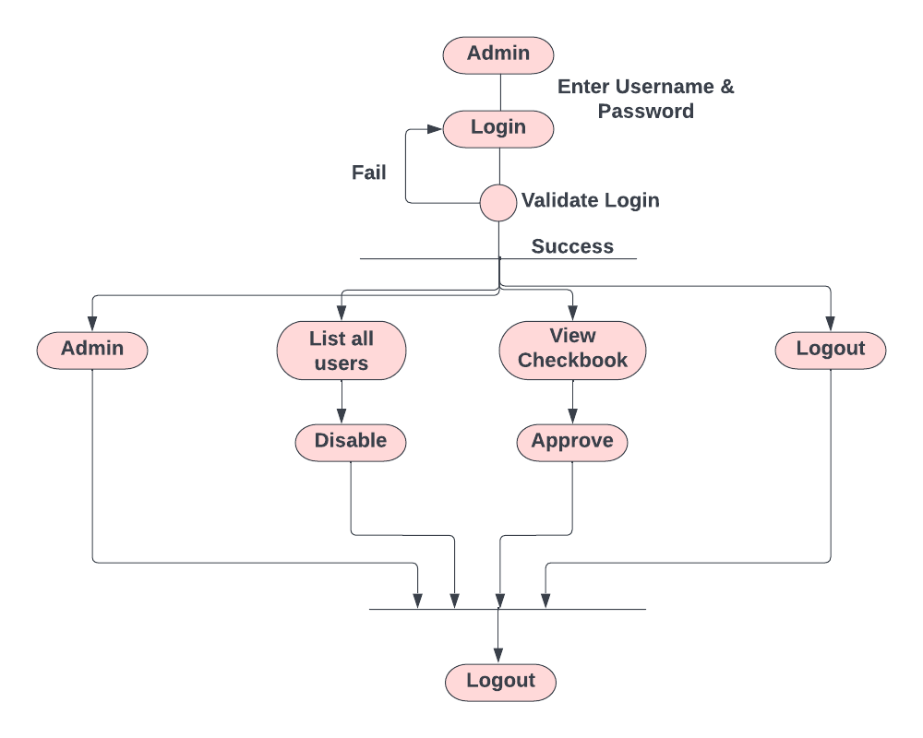
Admin Activity Diagram

Slide 13
MODULE CONTD... USER-module:
Register or Login to the Application
Deposit and Withdraw Money from the Account
View the Balance in Primary and Savings Account
Chequebook Requests and Loan Request for Different Accounts
User can do the Transaction.

Slide 14
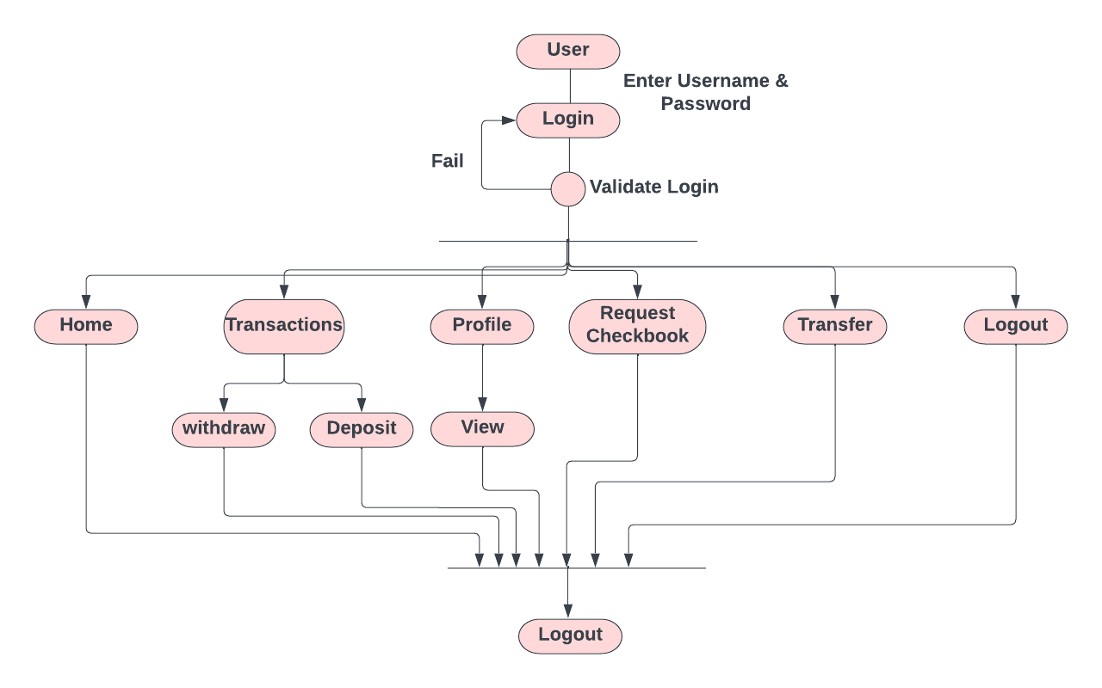
User Activity Diagram

Slide 15
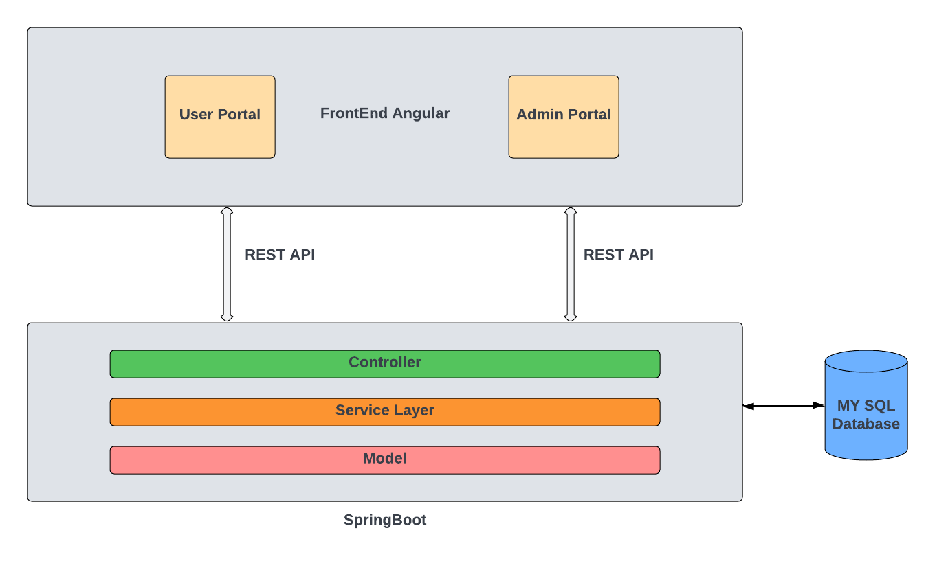
SYSTEM ARCHITECTURE

Slide 16
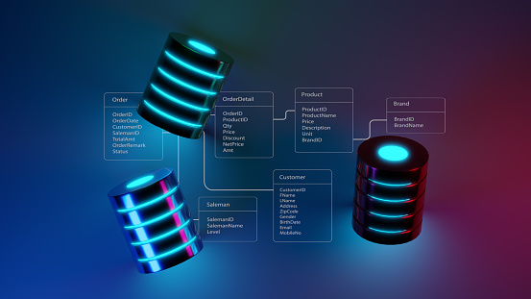
Database
Database : Online Banking
Tables:
1. admin
2. cheque_book
3. Loan
3. personal_transaction
4. primary_account
5. savings_account
6. transactions
7. user

Slide 17
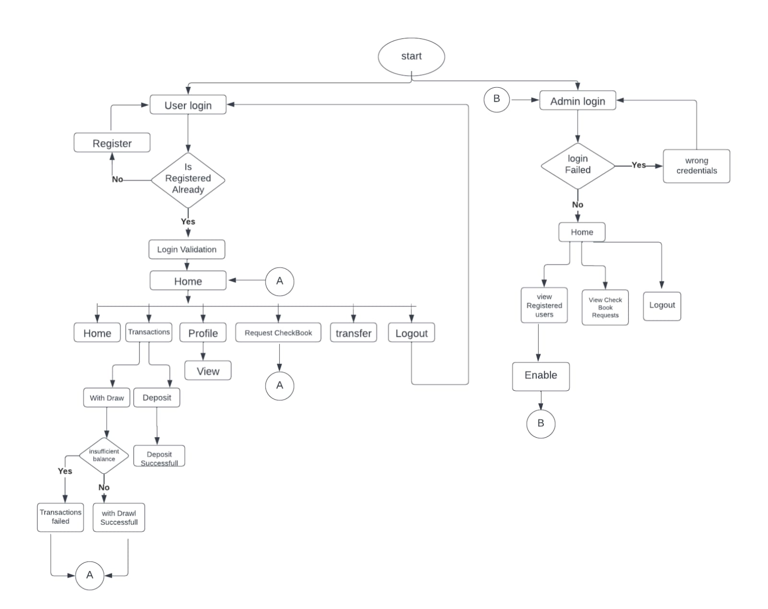
FLOW CHART

Slide 18
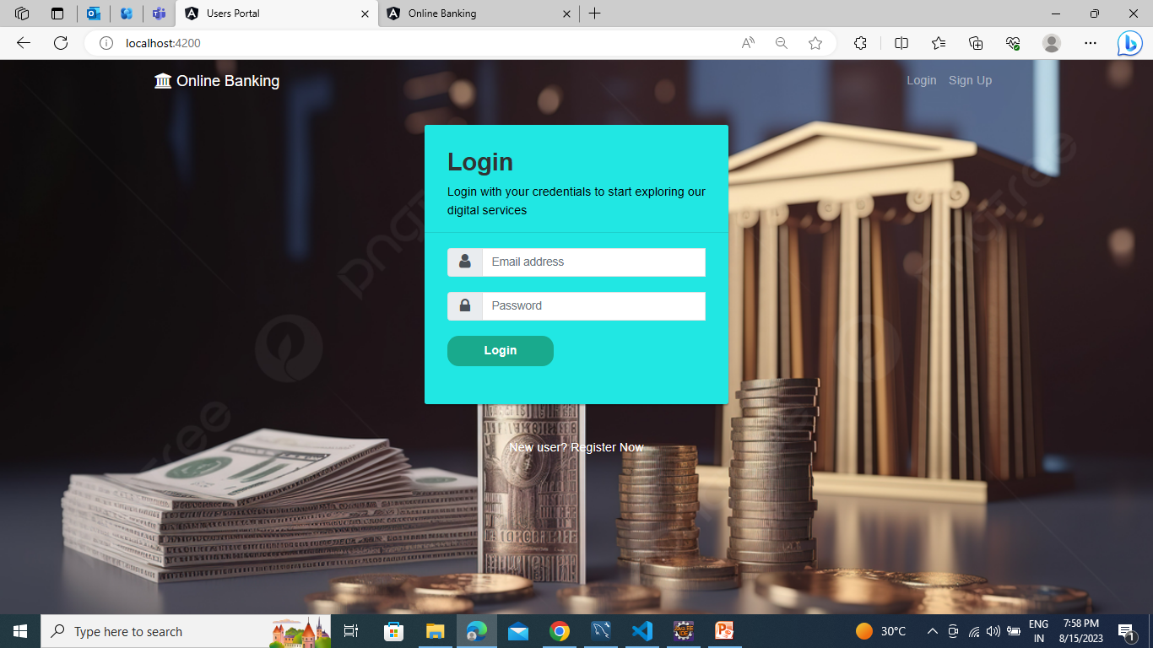
Output : Login PAGE

Slide 19
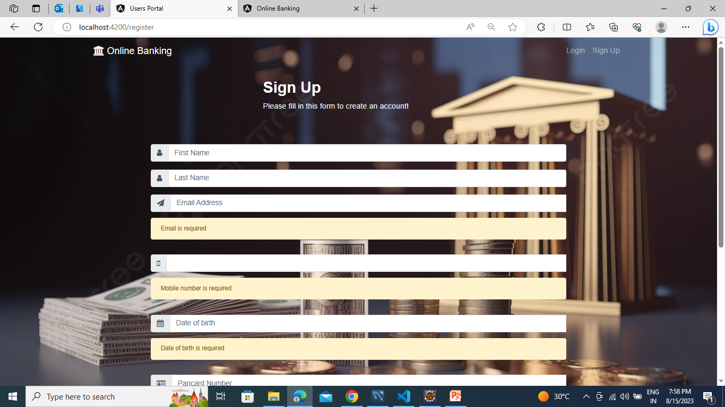
REGISTRATION PAGE:

Slide 20
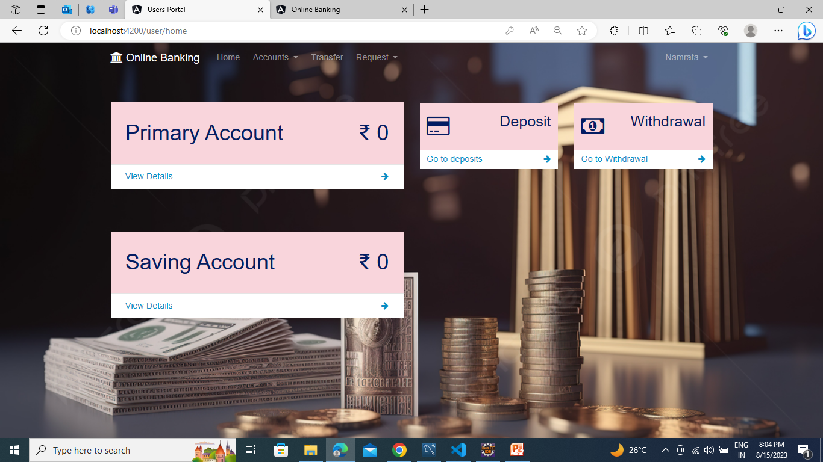
USER DASHBOARD:

Slide 21
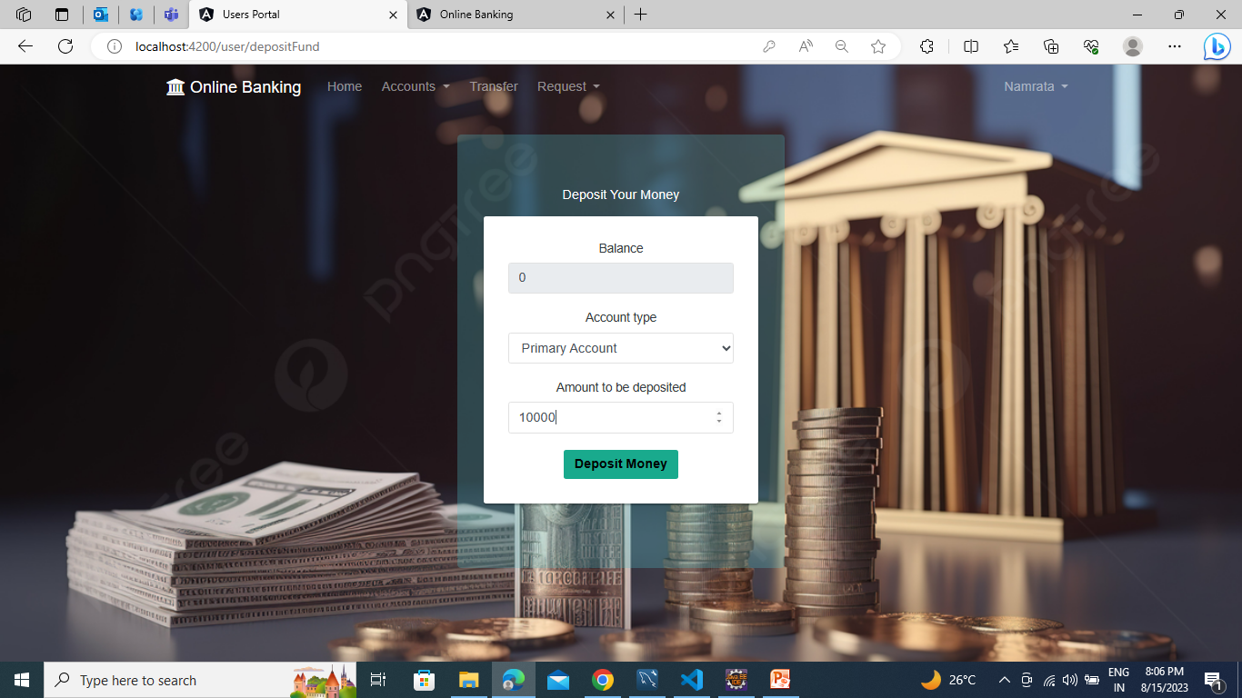
DEPOSIT MONEY:

Slide 22
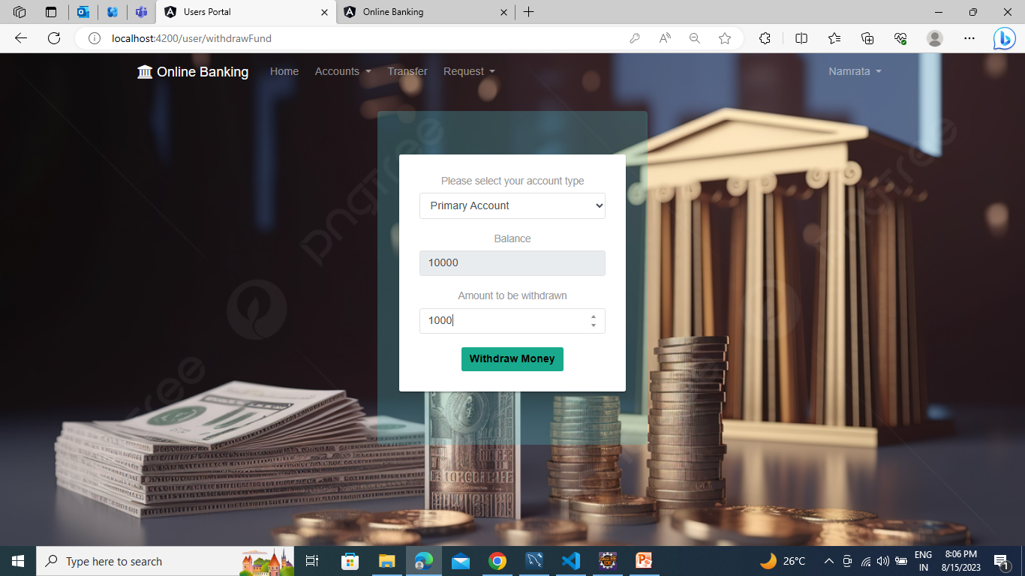
WITHDRAW MONEY:

Slide 23
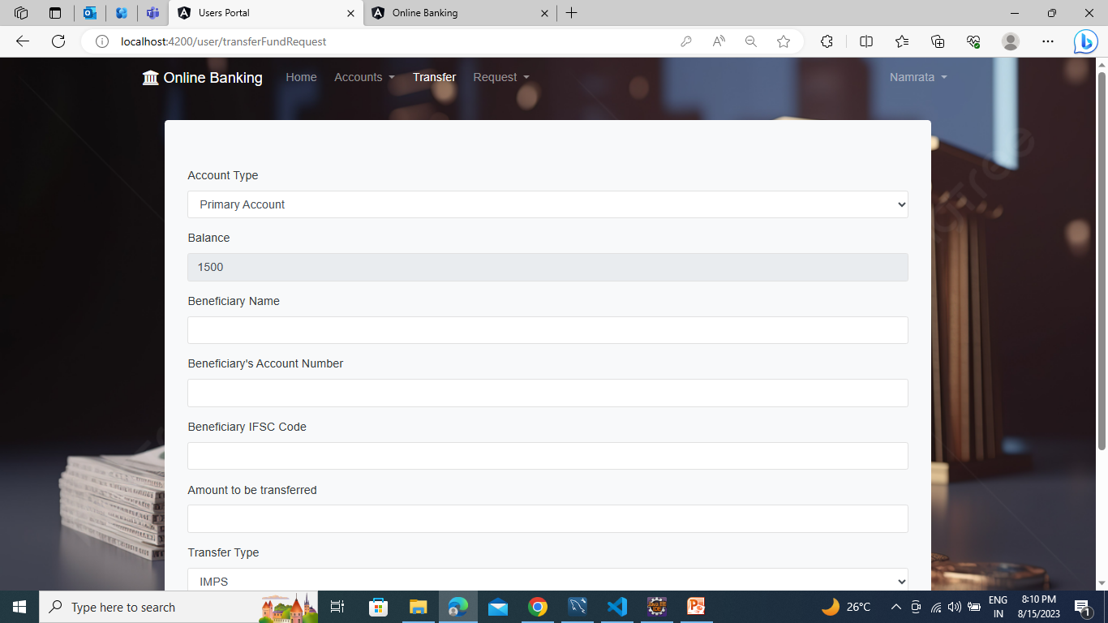
TRANSFER MONEY:

Slide 24
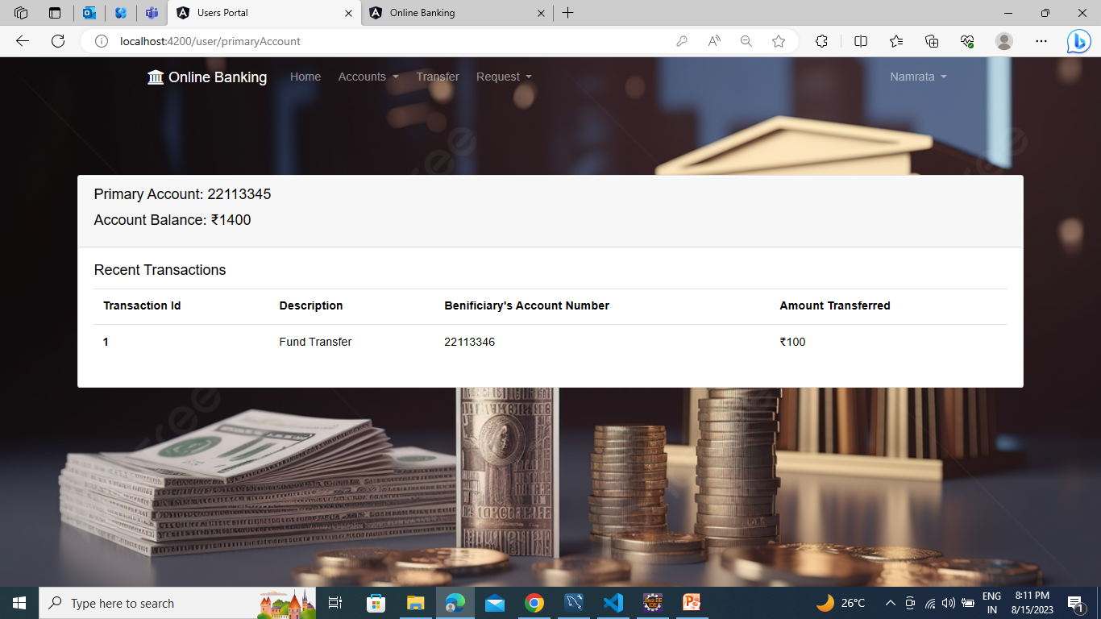
TRANSACTION HISTORY:

Slide 25
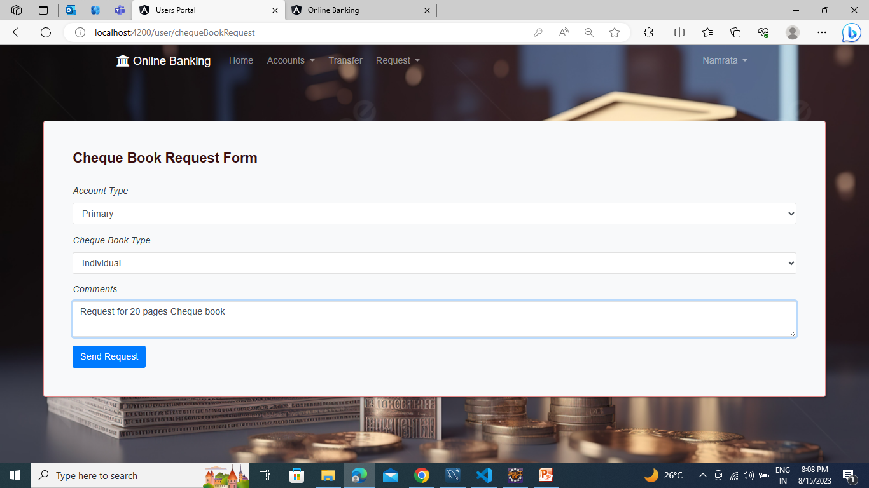
CHEQUE BOOK REQUEST:

Slide 26
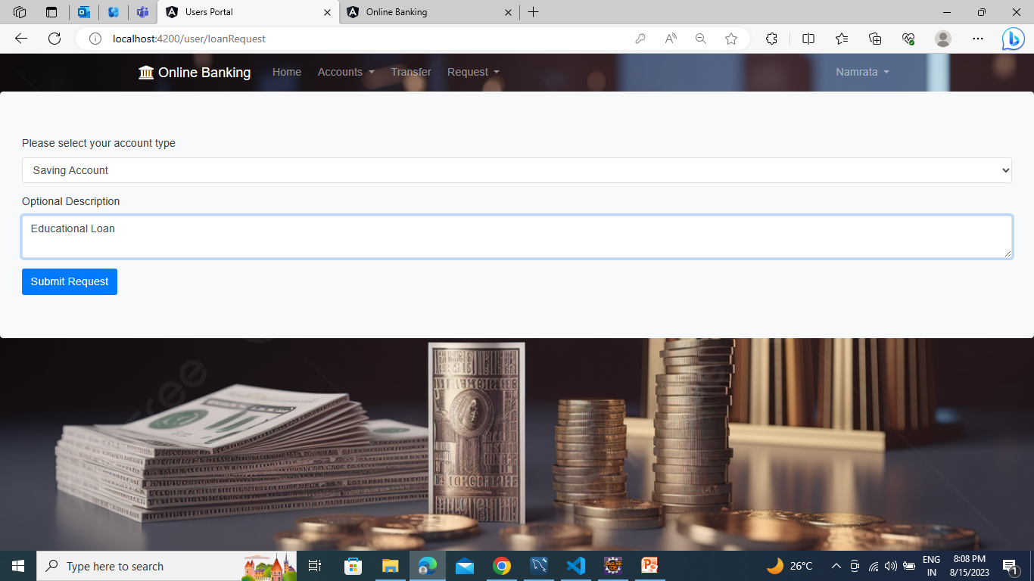
LOAN REQUEST:

Slide 27
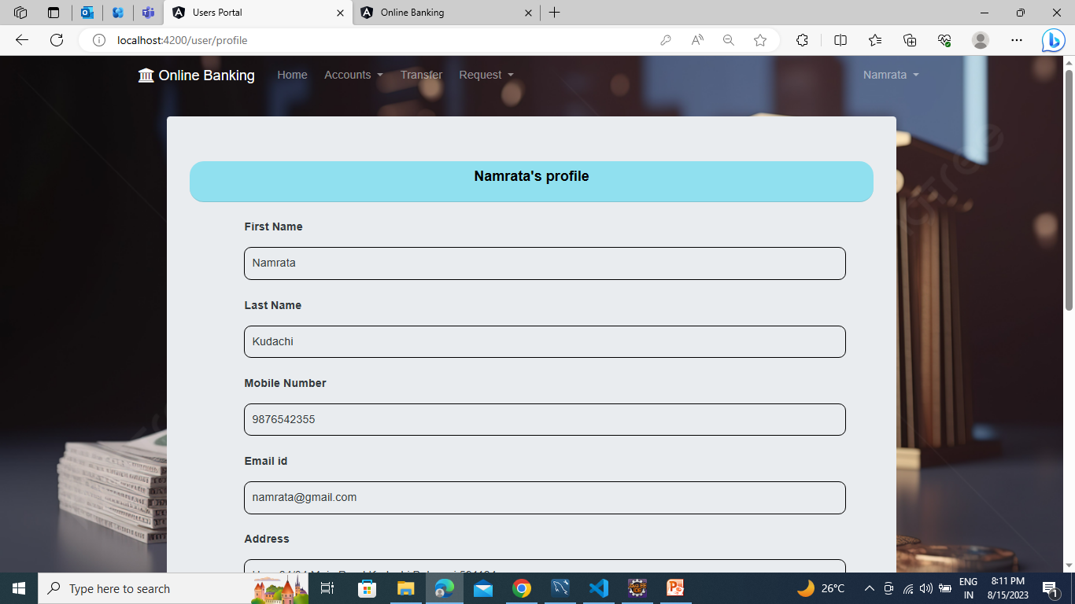
VIEW PROFILE:

Slide 28
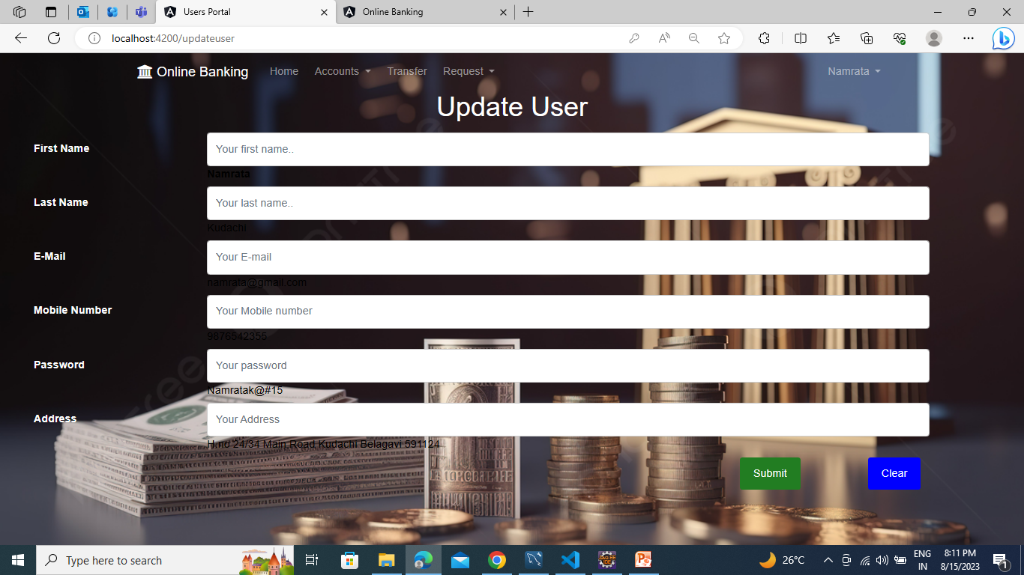
EDIT DETAILS:

Slide 29
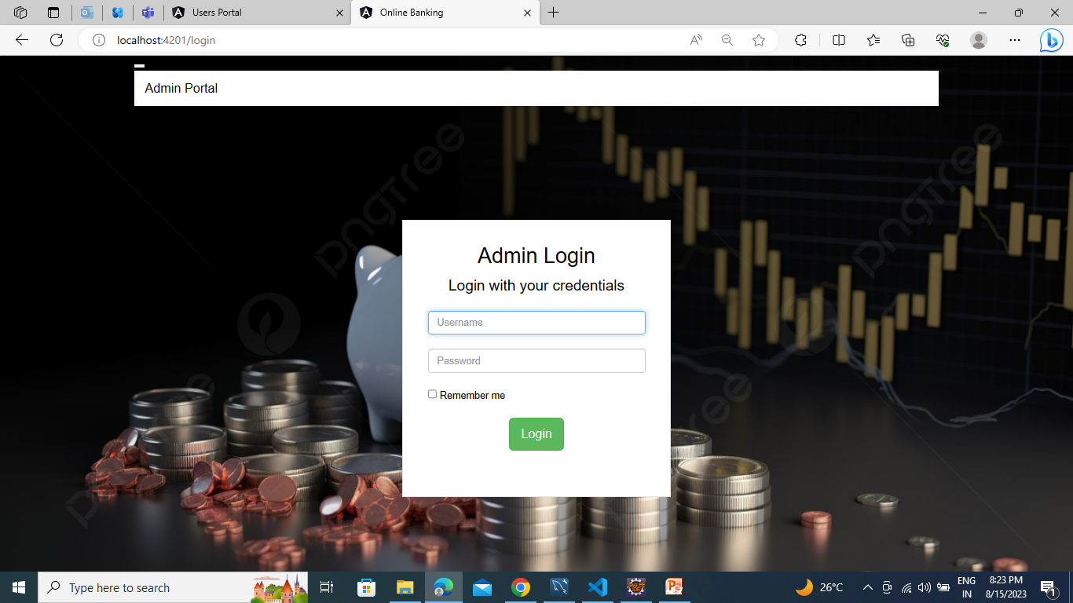
ADMIN LOGIN:

Slide 30
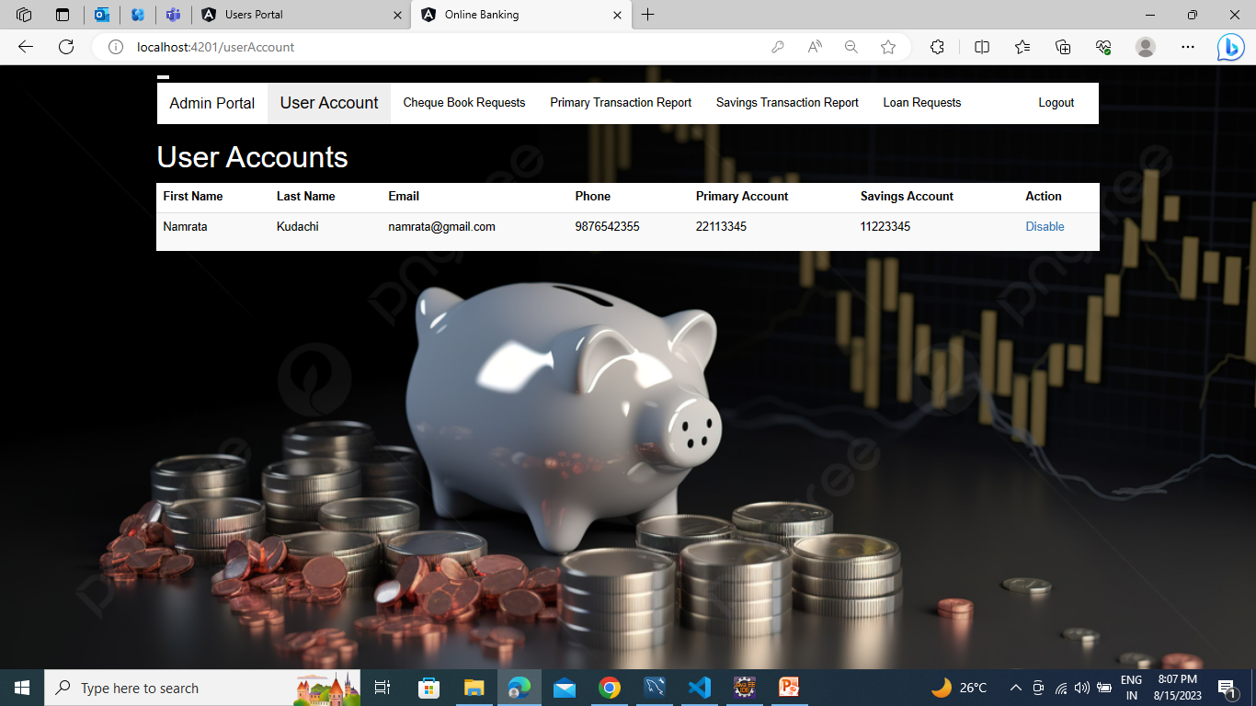
VIEW ALL USERS:

Slide 31

APPROVING CHEQUE BOOK REQUEST:

Slide 32

APPROVING LOAN REQUEST:

Slide 33
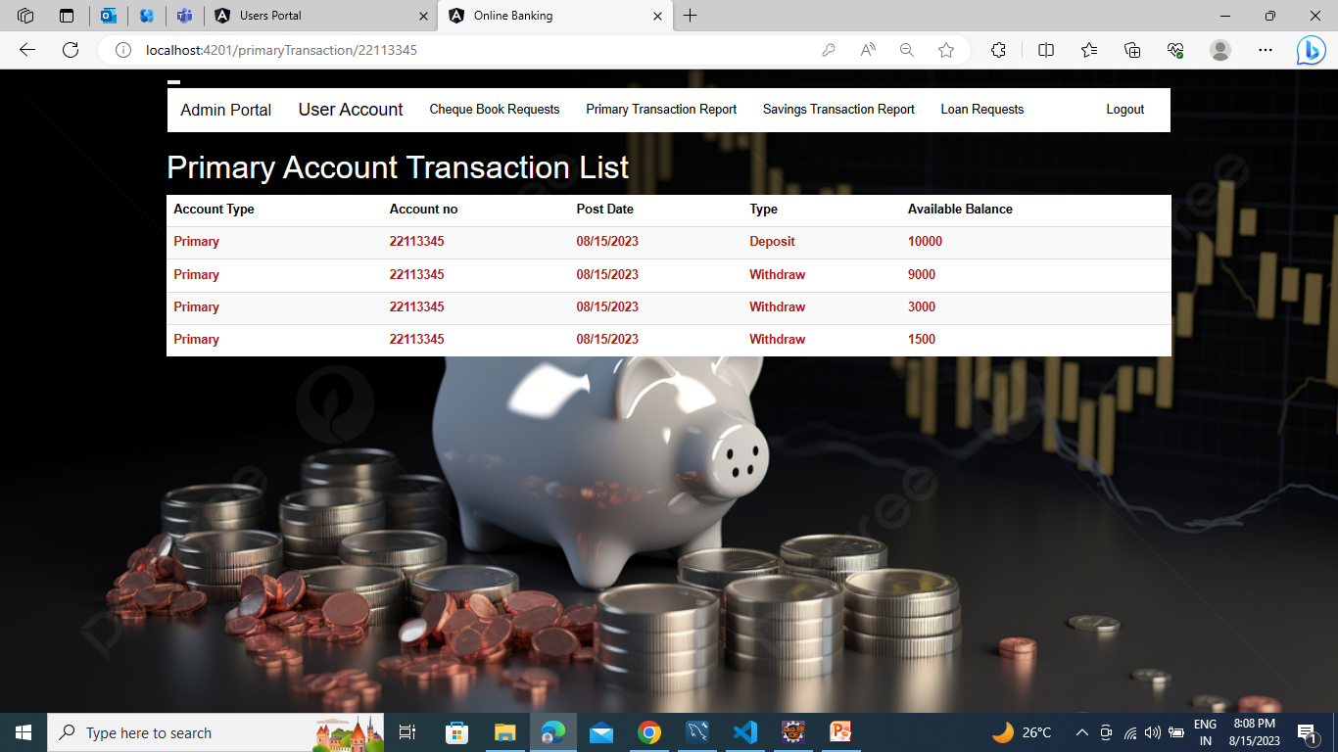
VIEW PRIMARY TRANSACTION REPORT:

Slide 34

Testing
Testing is done with:
Functional testing
Selenium
Test NG
Functional testing: Postman is an application that allows us to test APIs utilizing a graphical user interface. Some of Postman's advantages include the collection feature and the possibility to create different testing environments.
Selenium: Selenium is an open-source tool that automates web browsers. It provides a single interface that lets you write test scripts in programming languages.
Test NG: TestNG makes automated tests more structured, readable, maintainable and user-friendly.

Slide 35
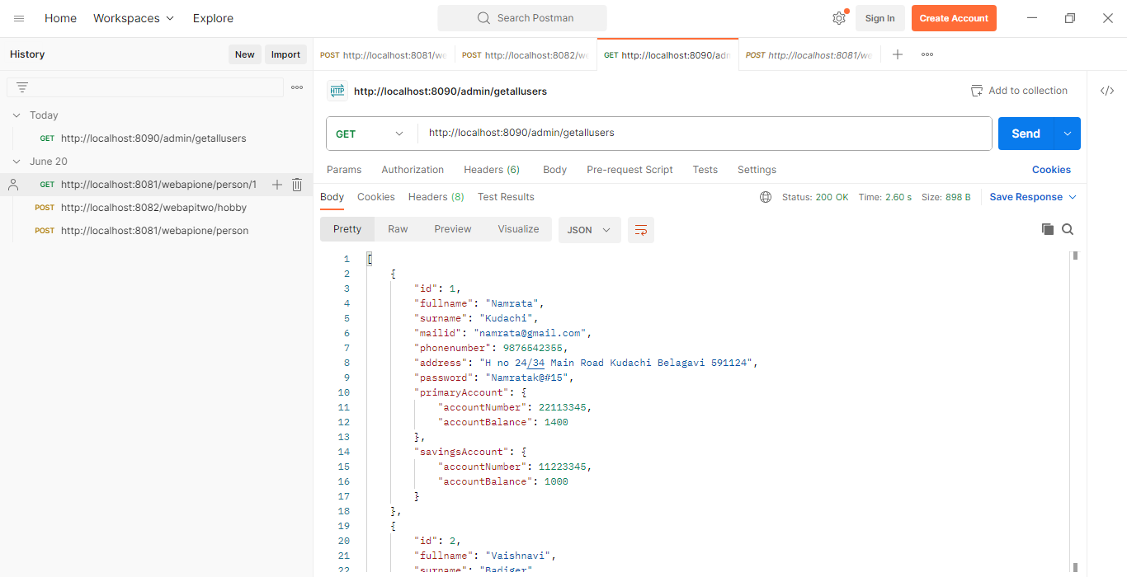
Testing - FUNCTIONAL TESTING

Slide 36
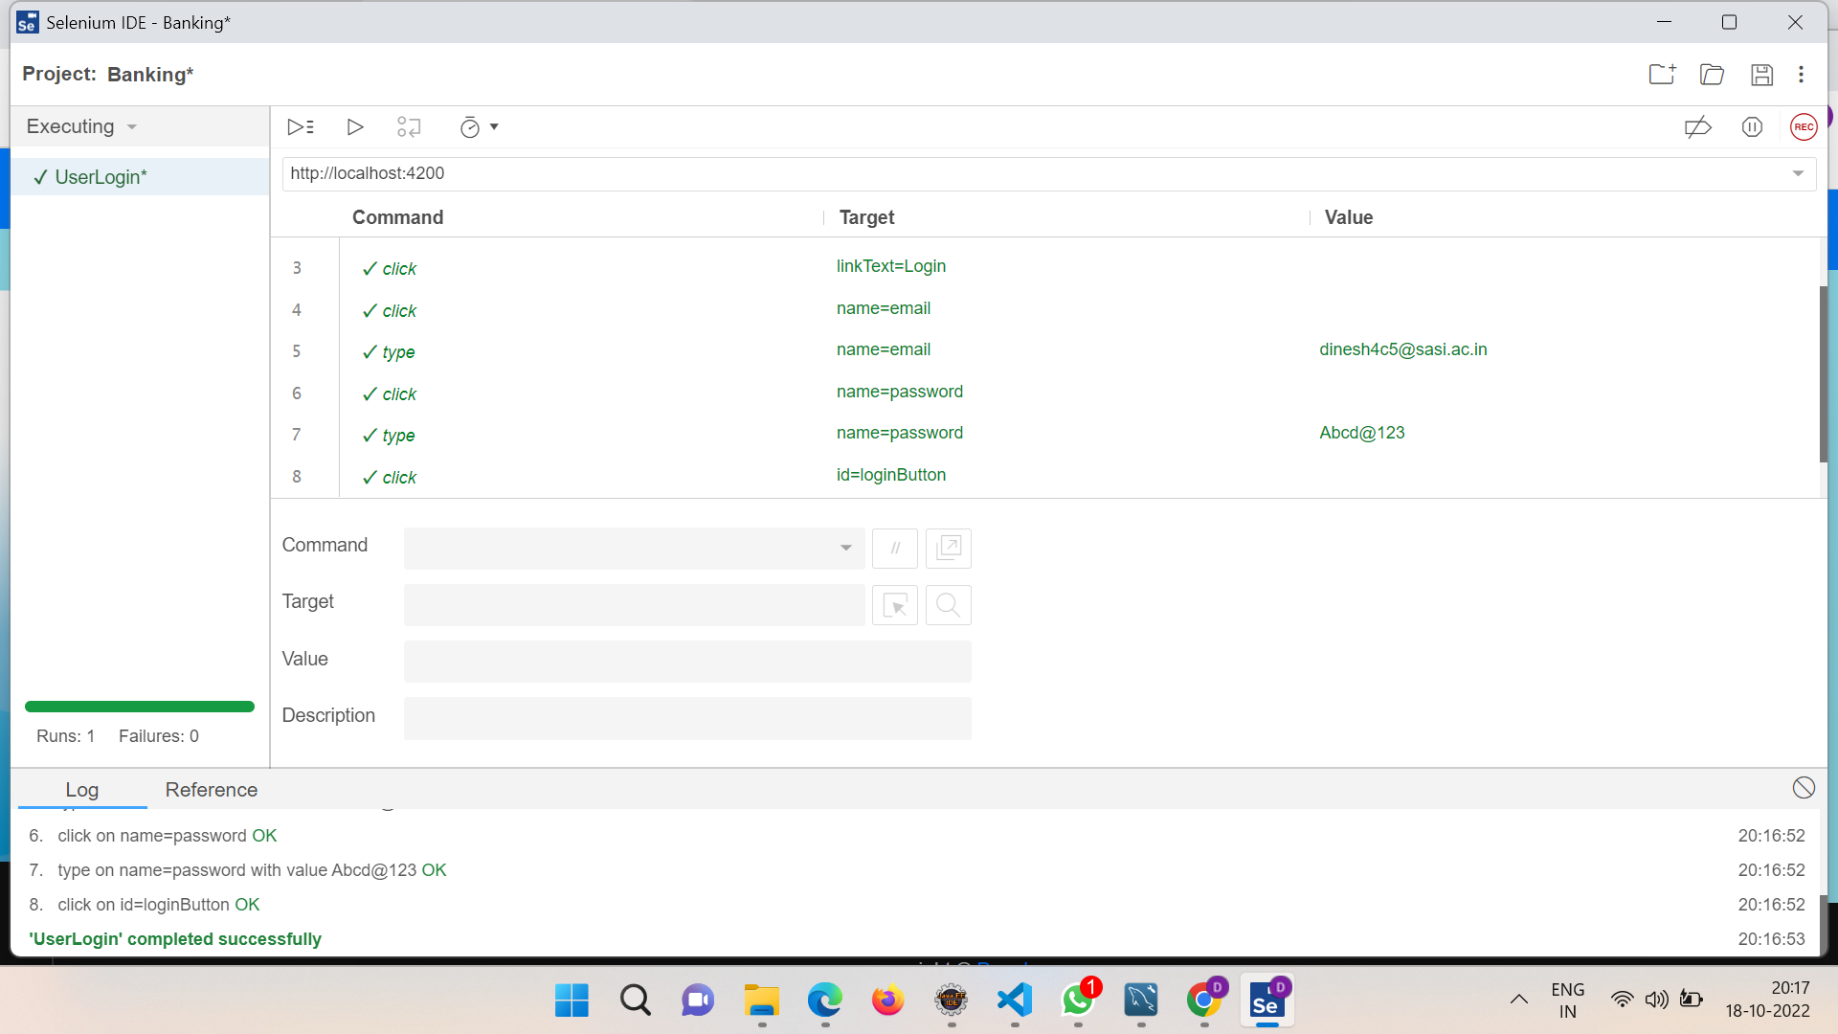
Testing – SELENIUM TESTING

Slide 37
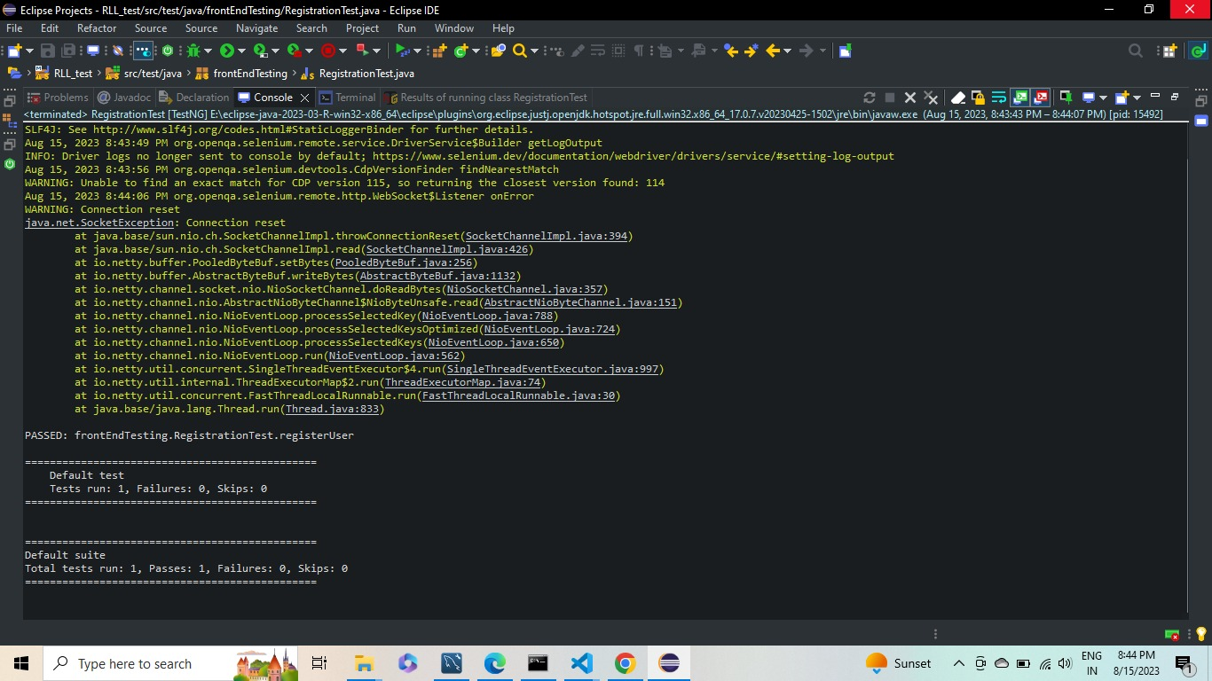
TESTING - TESTNG

Slide 38

GOALS
Reduced entry work.
Easy retrieval of information.
Reduced errors due to human intervention.
User friendly screens to enter the data.
Portable and Flexible for further enhancement
Fast finding of requested information.

Slide 39

Conclusion
The “Online Banking” was successfully designed and is tested for accuracy and quality.
During this project we have accomplished the objectives and this project meets the needs of the organization.
The developed will be used in searching, retrieving and generating information for the concerned requests.

Slide 40


